Slide 1
PROJECT PROPOSAL DOCUMENT
PROJECT PROPOSAL FOR GATE PASS SYSTEM

Slide 2
STUDENT DETAILS
REG. NO. COM/B/01-00106/2018
NAME. BORNFACE SONYE
PHONE NUMBER. 0798073204
EMAIL. Comb01-001062018@student.mmust.ac.ke
COURSE CODE. BCS 417
COURSE NAME. COMPUTER SCIENCE PROJECT 2
SUPERVISOR: MADAM RAMBIM

Slide 3
THE PROJECT TITLE
GATE PASS SYSTEM
The Gate Pass System is designed to securely track the entry and exit of properties such as laptops and vehicles into an institution. The system eliminates paper-based methods, enhances operational efficiency, and ensures secure property management.
It uses unique codes for laptops and number plates for vehicles, allowing security officers to authenticate items at multiple gates through synchronized kiosks.
The design ensures secure data management, real-time synchronization, and administrative control over item entries and exits.

Slide 4
ABSTRACT
The Gate Pass System is designed to securely track the entry and exit of properties such as laptops and vehicles into an institution. The system eliminates paper-based methods, enhances operational efficiency, and ensures secure property management.
It uses unique codes for laptops and number plates for vehicles, allowing security officers to authenticate items at multiple gates through synchronized kiosks.
The design ensures secure data management, real-time synchronization, and administrative control over item entries and exits.

Slide 5
1. INTRODUCTION
1.0 Background of the Study
Educational institutions and businesses often face challenges in tracking and managing assets like laptops and vehicles entering and exiting their premises.
Traditional paper-based systems are inefficient and prone to errors, leading to loss or mismanagement of valuable items.
The proposed Gate Pass System addresses these issues by automating property tracking, improving security, and streamlining operations.

Slide 6
2. PROBLEM DEFINATION
2.1 Current Workflow
Currently, institutions rely on paper-based systems to log properties entering and exiting the premises.
This workflow involves manual entry of details, which can lead to inaccuracies and inefficiencies.

Slide 7
2. PROBLEM DEFINATION
2.2 Weaknesses of the Current System
Manual Errors: Data entry is prone to human error.
Inefficiency: Paper logs can be lost or difficult to track.
Security Risks: Paper records lack encryption and are vulnerable to unauthorized access.

Slide 8
2. PROBLEM DEFINATION
2.3 The Proposed Idea
The proposed system will automate property registration, entry, and exit, using unique codes and passwords for secure authentication. Data will be synchronized across all gates, providing real-time tracking of items. This system eliminates paper logs, ensuring accuracy and security.

Slide 9
3. OBJECTIVES
3.1 General objective
To develop a Gate Pass System that automates recording entries and exits of laptops and vehicles, ensuring secure and efficient tracking across multiple gates.

Slide 10
3. OBJECTIVES
3.2 Specific Objectives
Implement kiosks at each entry and exit point for secure authentication using unique codes and passwords.
Implement main system that Automate registration of laptops and vehicles.
Enable synchronization of data across multiple kiosks at the gates.
Provide an admin interface for tracking Items and generating reports.

Slide 11
4. PROBLEM JUSTIFICATION
The current manual tracking methods are error-prone and inefficient. By automating the process, the proposed system will:
Reduce errors: Minimize human errors in logging data.
Enhance security: Secure items with passwords and unique identifiers.
Improve efficiency: Provide real-time tracking and reporting capabilities.

Slide 12
5. LITERATURE
5.1 The Current System
Manual Tracking: Institutions rely on paper logs to track items entering and exiting the premises.
Security Risks: Data is often vulnerable to tampering and unauthorized access.

Slide 13
5. LITERATURE
5.2 Challenges and Limitations of the Current System
Inefficiency: Paper logs are slow to process and often lost or misplaced.
Inaccuracy: Human errors during data entry cause discrepancies.
Lack of Security: Paper-based systems can be easily accessed and manipulated.

Slide 14
5. LITERATURE
5.3 Conceptual Design
5.3.1 Interfaces
The main system will provide an interface to register items, generate unique codes, track items’ entries and exits.
The main system will provide an admin interface for managing properties and tracking logs.
The kiosks deployed at each gate will present an interface for documenting items’ entries and authenticating items on exits.
The kiosks deployed at each gate will be used to interact with the main system to document items during entry and authenticate items on exit.
The kiosks will be synchronized across multiple gates.

Slide 15
5. LITERATURE
5.3 Conceptual Design
5.3.2 Report Generation
The main system will provide an admin interface for managing respective items and tracking logs.

Slide 16
5. LITERATURE
5.3 Conceptual Design
5.3.3 Data Management
Efficient data management will ensure secure storage, retrieval, and processing of user information, item details, and tracking logs.

Slide 17
6. METHODOLODY
6.1 Model
An Agile development approach will be followed to ensure continuous improvement and integration of user feedback.

Slide 18
6. METHODOLODY
6.2 Phases
Consisting of the following stages:
Planning Phase: Define project requirements.
Designing Phase: Design the system architecture.

Slide 19
6. METHODOLODY
6.2 Phases
Development Phase:-
Develop the main system using Django web framework.
Develop the centralized database using PostgreSQL.
Develop the kiosk software using C++ for efficient interaction with the hardware to improve performance.

Slide 20
6. METHODOLODY
6.2 Phases
Testing Phase:-
Perform unit testing for the main system testing.
Perform unit testing for the kiosk software.
Perform integration testing for the integrated system.
Perform functional and security testing
Perform user acceptance testing.

Slide 21
6. METHODOLODY
6.2 Phases
Deployment Phase:-
Deploy the main system on a central server.
Install the kiosk software on the hardware.
Deploy the kiosk device at each entry and exit point.

Slide 22
6. METHODOLODY
6.2 Phases
Training Phase:-
Train the administrative user on how to add new item, how to track logs and how to generate reports from main system.
Train the security officers at each gate how to use the kiosk devices.

Slide 23
6. METHODOLODY
6.2 Phases
Documentation Phase:-
Document all the development procedures for all modules of the main system.
Document the development guide of the kiosk software.
Document the integration procedure for integrating the kiosk software to communicate with the main system.
Document the deployment procedure for the main system.
Document the hardware requirements for the kiosk software.
Document the installation procedure for installing the kiosk software on its hardware.
Document the configuration procedure for setting up the kiosk device into an operational device.
Document all user guides.

Slide 24
6. METHODOLODY
6.2 Phases
Maintenance Phase:-
Continuous maintenance of the main system.
Continuous maintenance of the kiosk software.
Continuous maintenance of kiosk device at each entry and exit point.

Slide 25
6. METHODOLOGY
6.2 System Requirements
6.2.1 Functional Requirements
Registration: Capture item details and generate unique codes for laptops.
Entry/Exit Authentication: Securely authenticate items at the gate.
Synchronization: Real-time synchronization of data across all gates.

Slide 26
6. METHODOLOGY
6.2 System Requirements
6.2.2 Non-Functional Requirements
Highly Responsive: Ensure fast authentication and synchronization.
Easy to Use: Simple, intuitive interfaces for security officers and administrators.
Security: Data encryption and secure password management.
Performance and Reliability: The system should handle multiple gates and large datasets efficiently.

Slide 27
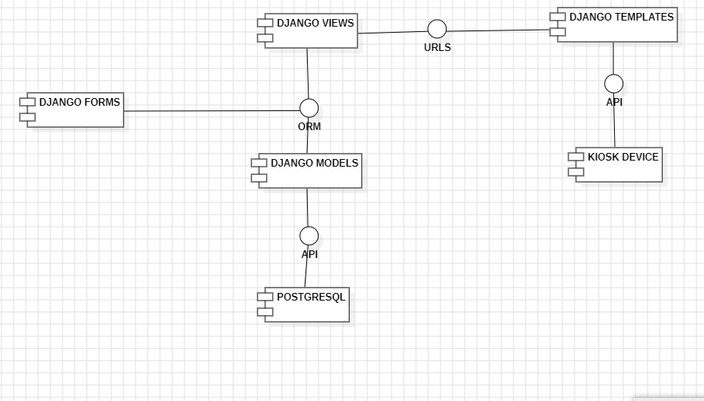
7. SYSTEM DESIGN: The Component Diagram;

Slide 28
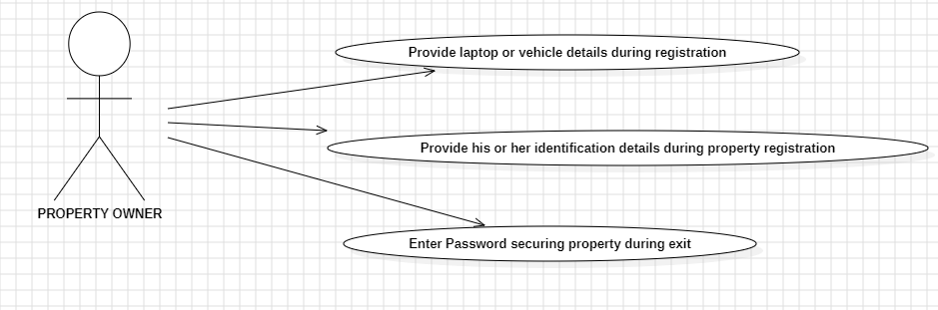
7. SYSTEM DESIGN: Use Case Diagram (PROPERTY OWNER);

Slide 29
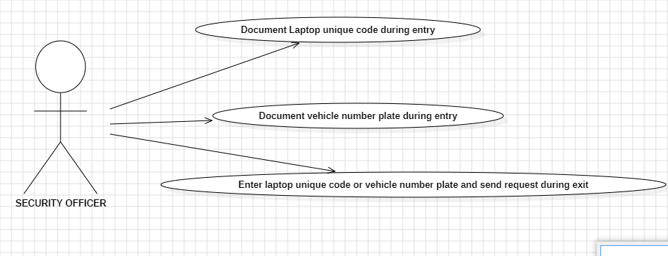
7. SYSTEM DESIGN: Use Case Diagram (SECURITY OFFICER);

Slide 30
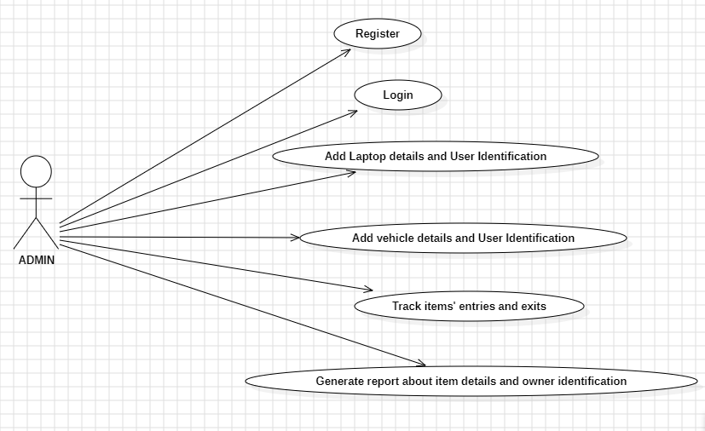
7. SYSTEM DESIGN: Use Case Diagram (ADMIN);

Slide 31
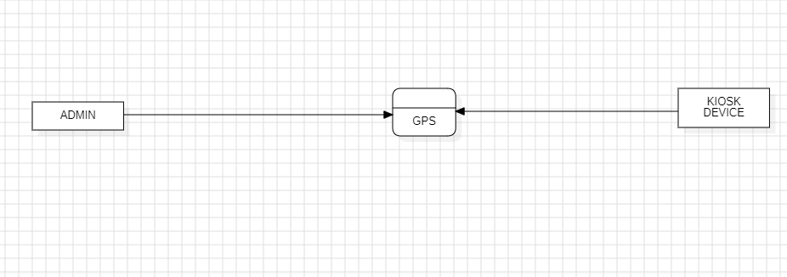
7. SYSTEM DESIGN: Context Diagram;

Slide 32
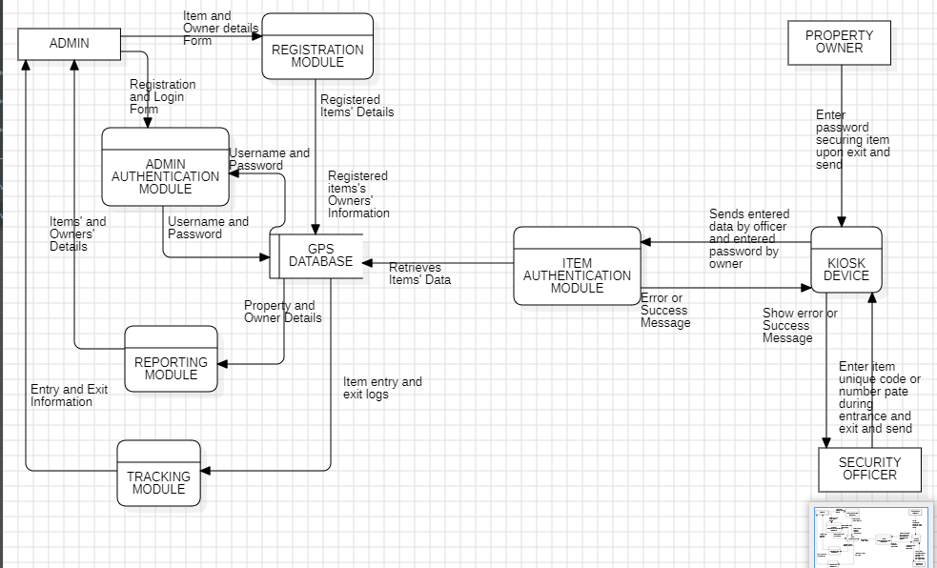
7. SYSTEM DESIGN: Level 1 DFD;

Slide 33
7. SYSTEM DESIGN: Database Design;
Laptop Details: Serial number, MAC address, owner ID, unique code.
Vehicle Details: Number plate, owner ID, password.
Owner Details: National ID, name, email, password.
Entry/Exit Logs: Time and date of property movements.

Slide 34
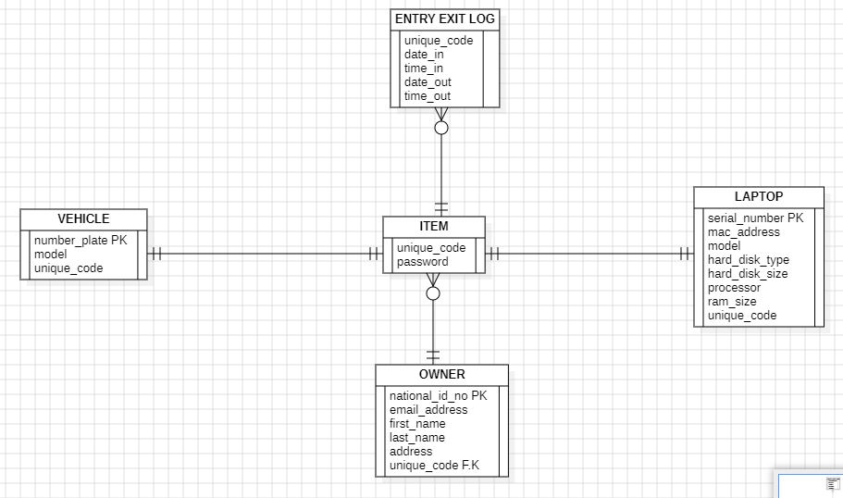
7. SYSTEM DESIGN: Database Design;

Slide 35
7. SYSTEM DESIGN: ML Algorithm;
Registration:
Capture item details (MAC, serial number, etc.).
Generate a unique code for laptops or use the vehicle number plate.
Save item and owner details in the database.
Entry/Exit Authentication:
Security officer inputs the unique code or number plate.
Validate the code against the database.
Prompt for the owner’s password.
On successful password match, log entry or exit time.

Slide 36
7. SCHEDULE
Initiation Phase:
November 27th - December10th: Requirements gathering and initial design
Planning Phase:
December 11th - January 1st: UI/UX design and database setup
Implementation Phase:
January 2nd - February 25th: Core functionality development (item registration, item authentication, tracking and reporting functionalities)
February 26th - March 10th: Implementation of kiosk software and integration with the main system
Testing Phase:
March 11th - March 19th: Testing and bug fixing
Deployment Phase:
March 20th - March 29th: Deployment and final documentation

Slide 37
8. BUDGET(2.9 Million Ksh.)
Category | Cost (Ksh)
Human Resources | 800,000
Development Tools and Deployment | 750,000
Third-Party Software/Tools | 550,000
Hardware (Kiosks, Printers, etc.) | 400,000
Maintenance Cost, User training and Documentation | 400,000

